Slide 1
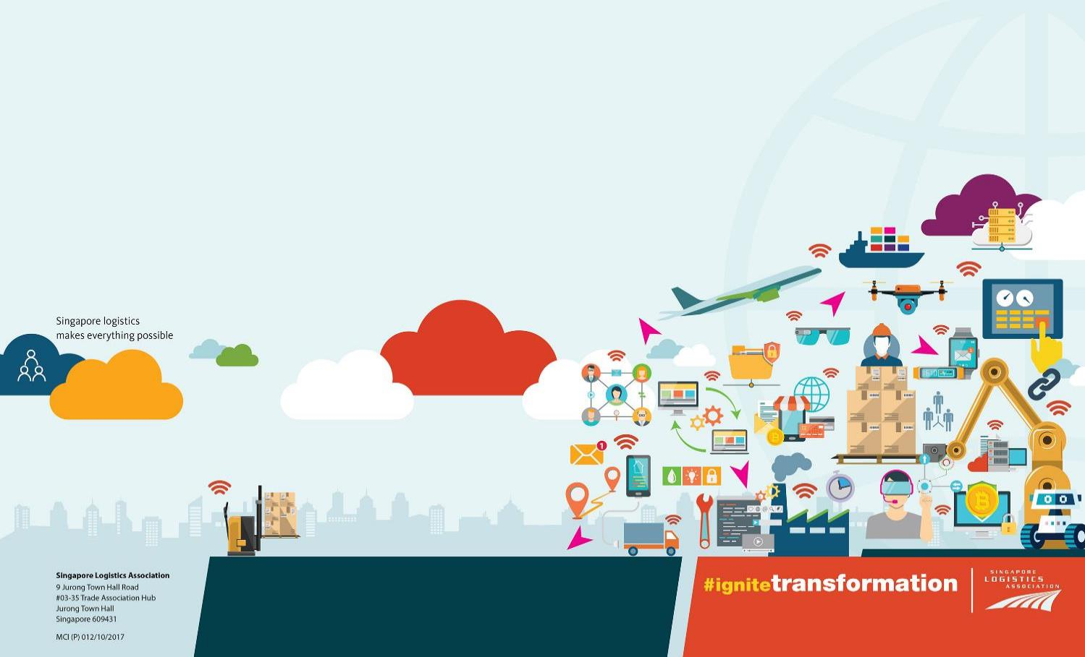

Global Supply Chain – Experience best practices to overcome the pandemic and ensure business operations in the post COVID-19 ‘new normal’
Ho Chi Minh City- 8 October 2021
Mr. Stanley Lim, BBM, PBM, MCILT
Council Member & Chairman, Internationalisation Committee,
Singapore Logistics Association

Slide 2



About Singapore Logistics Association
Established in 1973 by logisticians, for logisticians
Represents over 615 logistics enterprises
Transporters and haulers
Warehousing, storage and distribution
Global freight forwarders
Container depots
Project logistics
Logistics technologies and platforms
The Logistics Academy offers accreditations and certifications

Slide 3
Key responses to the pandemic
Singapore’s Ministry of Trade & Industry (MTI) announced commitments made with other countries to secure supply chains amid COVID-19 pandemic
For example, Singapore continues to boost connectivity as a logistics hub, working with other ASEAN countries to ensure the continued supply of essential goods via the Regional Comprehensive Economic Partnership (RCEP) agreement. The RCEP is set to be the world's largest trade pact and involves all 10 ASEAN nations as well as Australia, China, Japan, New Zealand and South Korea.
Fiscal prudence (generating reserves) and discipline (spending control) in past years have afforded Singapore the resources needed to support and restore the adverse economic impacts of a crisis without taking on substantial debt.
In particular, Small and Medium Enterprises (SMEs) were a priority for support.
Continue to support technology and digitalisation efforts amidst pandemic

Slide 4
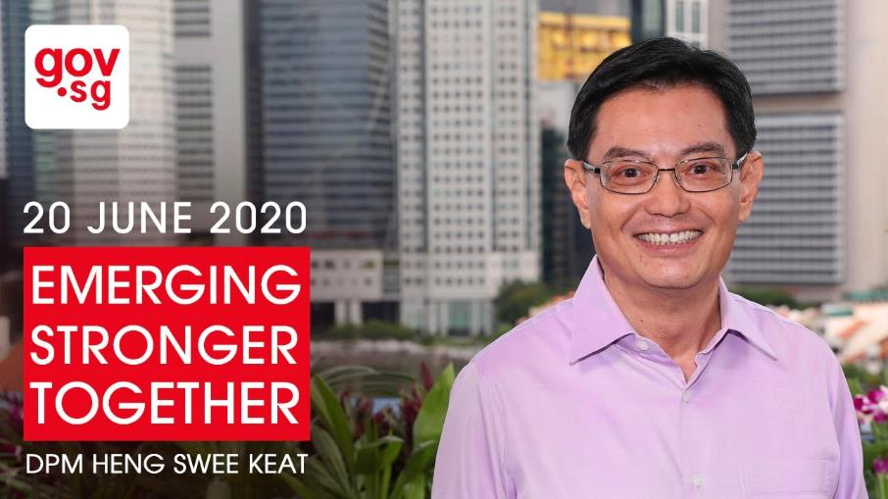
Singapore’s response to the pandemic
Turning crisis into opportunity
The Emerging Stronger Taskforce (EST) was formed:
To examine the impact of the COVID-19 crisis on our economy, businesses and workers.
To provide recommendations to the Future Economy Council (FEC) on how Singapore can stay resilient and create new sources of growth moving forward.

Slide 5
Post COVID Focus and the New Normal
S
Business consolidations – less or non profitable businesses will have to transform
New business opportunities in cold chain, healthcare and e-commerce
Shift from services to goods (cannot travel)
Consumer behavioral changes causes rise in digital adoptions and new platforms
Data driven decisions
Unplanned disruptions in global supply chains due to covid shutdowns – disrupted cargo movements, more bottlenecks, slower flow, inventory buildup of essential goods, increase in freight rates, drop in air freight capacity
Hybrid working arrangement (e.g. split teams for operations, and a mix of employees working from home)
Shift from ‘Just-in-time’ to ‘Just-in-case’ supply chains and mentality
Industry needs to work closely with governments to support/build infrastructures and logistics facilities that can handle specialised cargos, and accommodate essential goods required for national survival
Diversification of supply chain risks
Global Trends and Transformations
Business as Usual But BE EVER READY

Slide 6
What does it mean for SEA countries?
Greater need for borderless arrangements
Manufacturers are re-strategizing and relocating (e.g. more Chinese manufacturers are moving into Vietnam)
Transform logistics practices – leverage digitalisation and less labour intensive
Sustainability will be a game-changer as governments and global shippers/businesses prioritise this as a top agenda. Companies will need to stay ahead of the game and provide greener logistics solutions in the future.

Slide 7
The Changing Landscape
Growth of Asian Economy
Increased Manufacturing in ASEAN
New Trade Pacts Shifting Trade Flows
China’s Belt and Road Initiative (BRI)
S
Omni-Channel Retail
Sharing Economy
Digital Manufacturing
Additive Manufacturing
Robots
ASRS
Internet of Things
Data Analytics
Rise of Asia & ASEAN
Emerging Business &
Manufacturing Trends
Advancements in Technology
Growth Opportunities for Logistics
Increased Freight Transportation
Enhanced Productivity
New
Capabilities
Regional
Expansions
Deepened Collaborations

Slide 8
Logistics Industry Transformation Map (ITM)
Singapore as a Globally Leading Logistics Hub underpinned by Operations Excellence, Innovation and a Strong Singaporean Core
Develop new capabilities to tap on emerging business opportunities
Support Small and Medium Enterprises (SMEs) in tapping on innovation
Drive adoption of technology and Best-In-Class practices
Steer high growth enterprises’ resources towards specialised sectors
Optimise assets utilisation amongst industry
Cluster activities within value chain to deploy system-level technologies
Improve domestic logistics productivity
Enhance talent development and career planning in SMEs
Professionalise the logistics workforce
Uplift image of the logistics industry
Leverage increased specialisation of high growth enterprises to drive overseas expansion
Cluster complementary companies to offer regional solutions
Build differentiated trade connectivity into global markets and capture new international trade flows through Singapore
Innovation
Productivity
Manpower Supply & Skills
Internationalisation
Key Enablers: Strengthen Trade Associations and Chambers to support transformation of SMEs

Slide 9
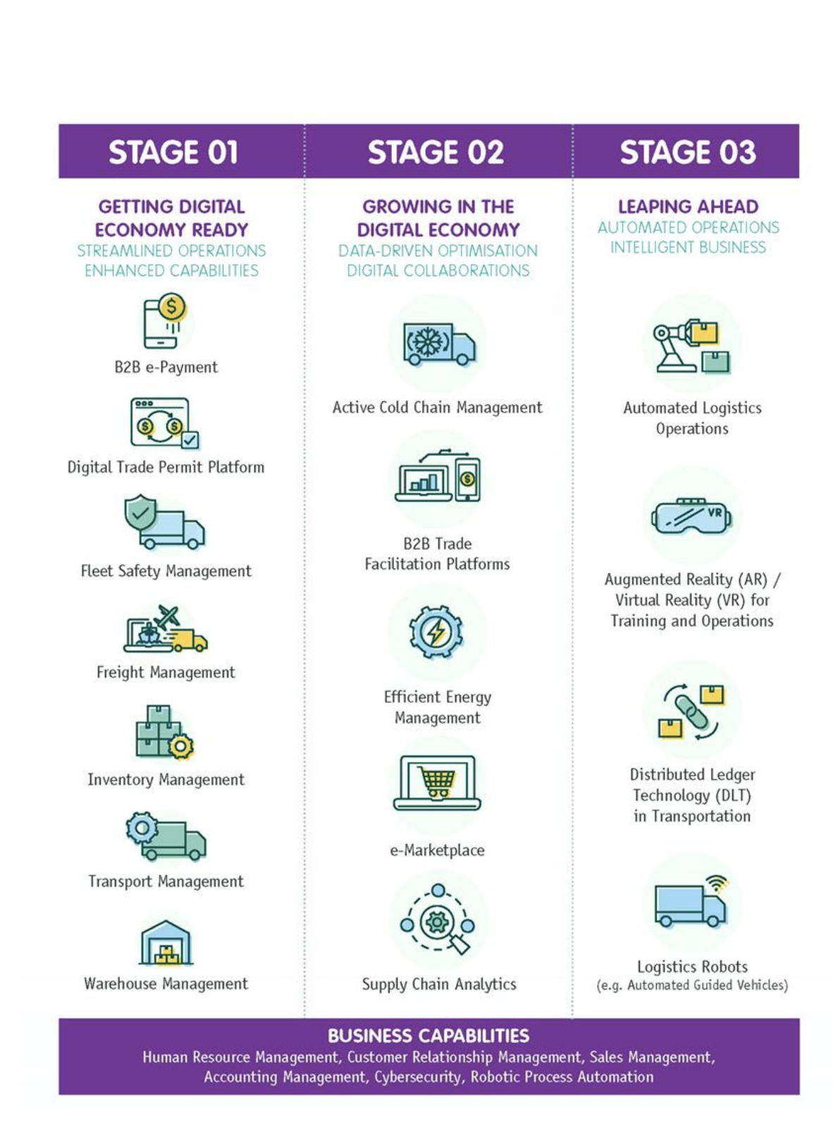
Logistics Industry Digital Plan
Aligned to the Logistics Industry Transformation Map (ITM), the Logistics Industry Digital Plan (IDP) aims to make going digital simple for SMEs.
Introduces new solutions that meet the current and anticipated future needs of companies in the Logistics industry.
Digital Training Roadmap helps SMEs identify relevant training programmes to upskill their workers as their businesses transform digitally.
An initiative by The Infocomm Media Development Authority (IMDA), in partnership with Enterprise Singapore (ESG) and the industry

Slide 10
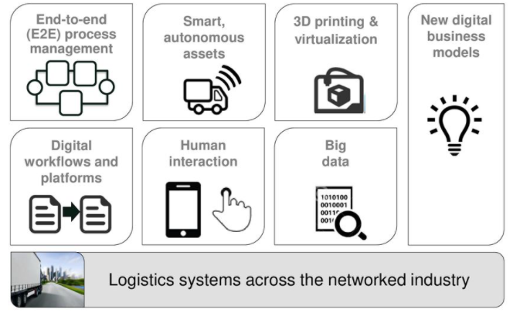
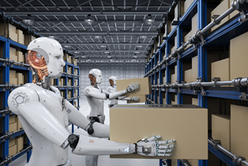
Industry 4.0

Slide 11
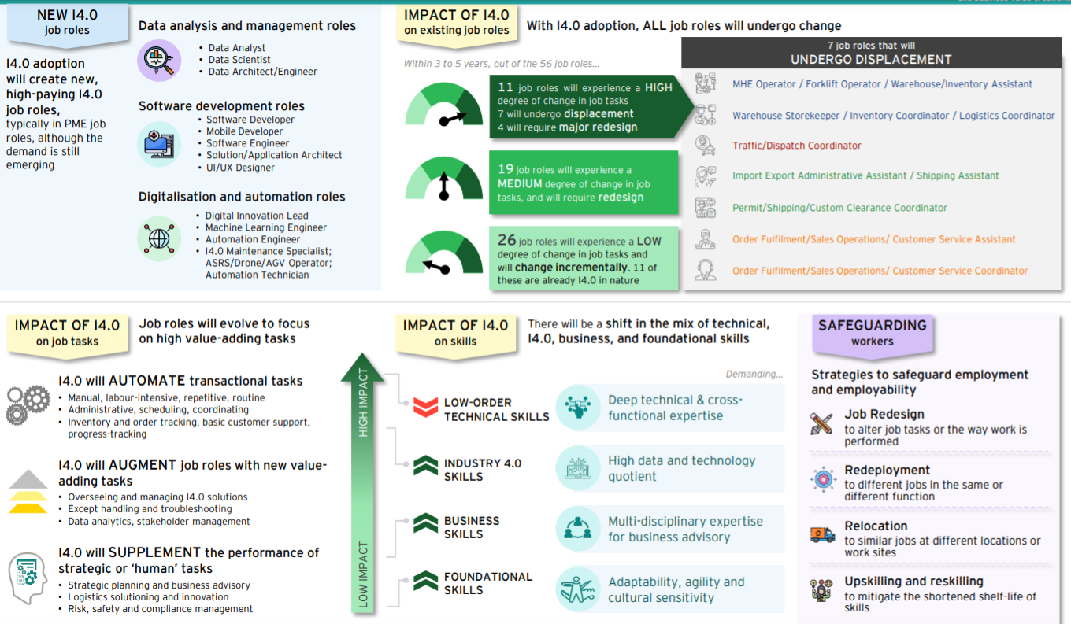
Impact on Future Jobs

Slide 12
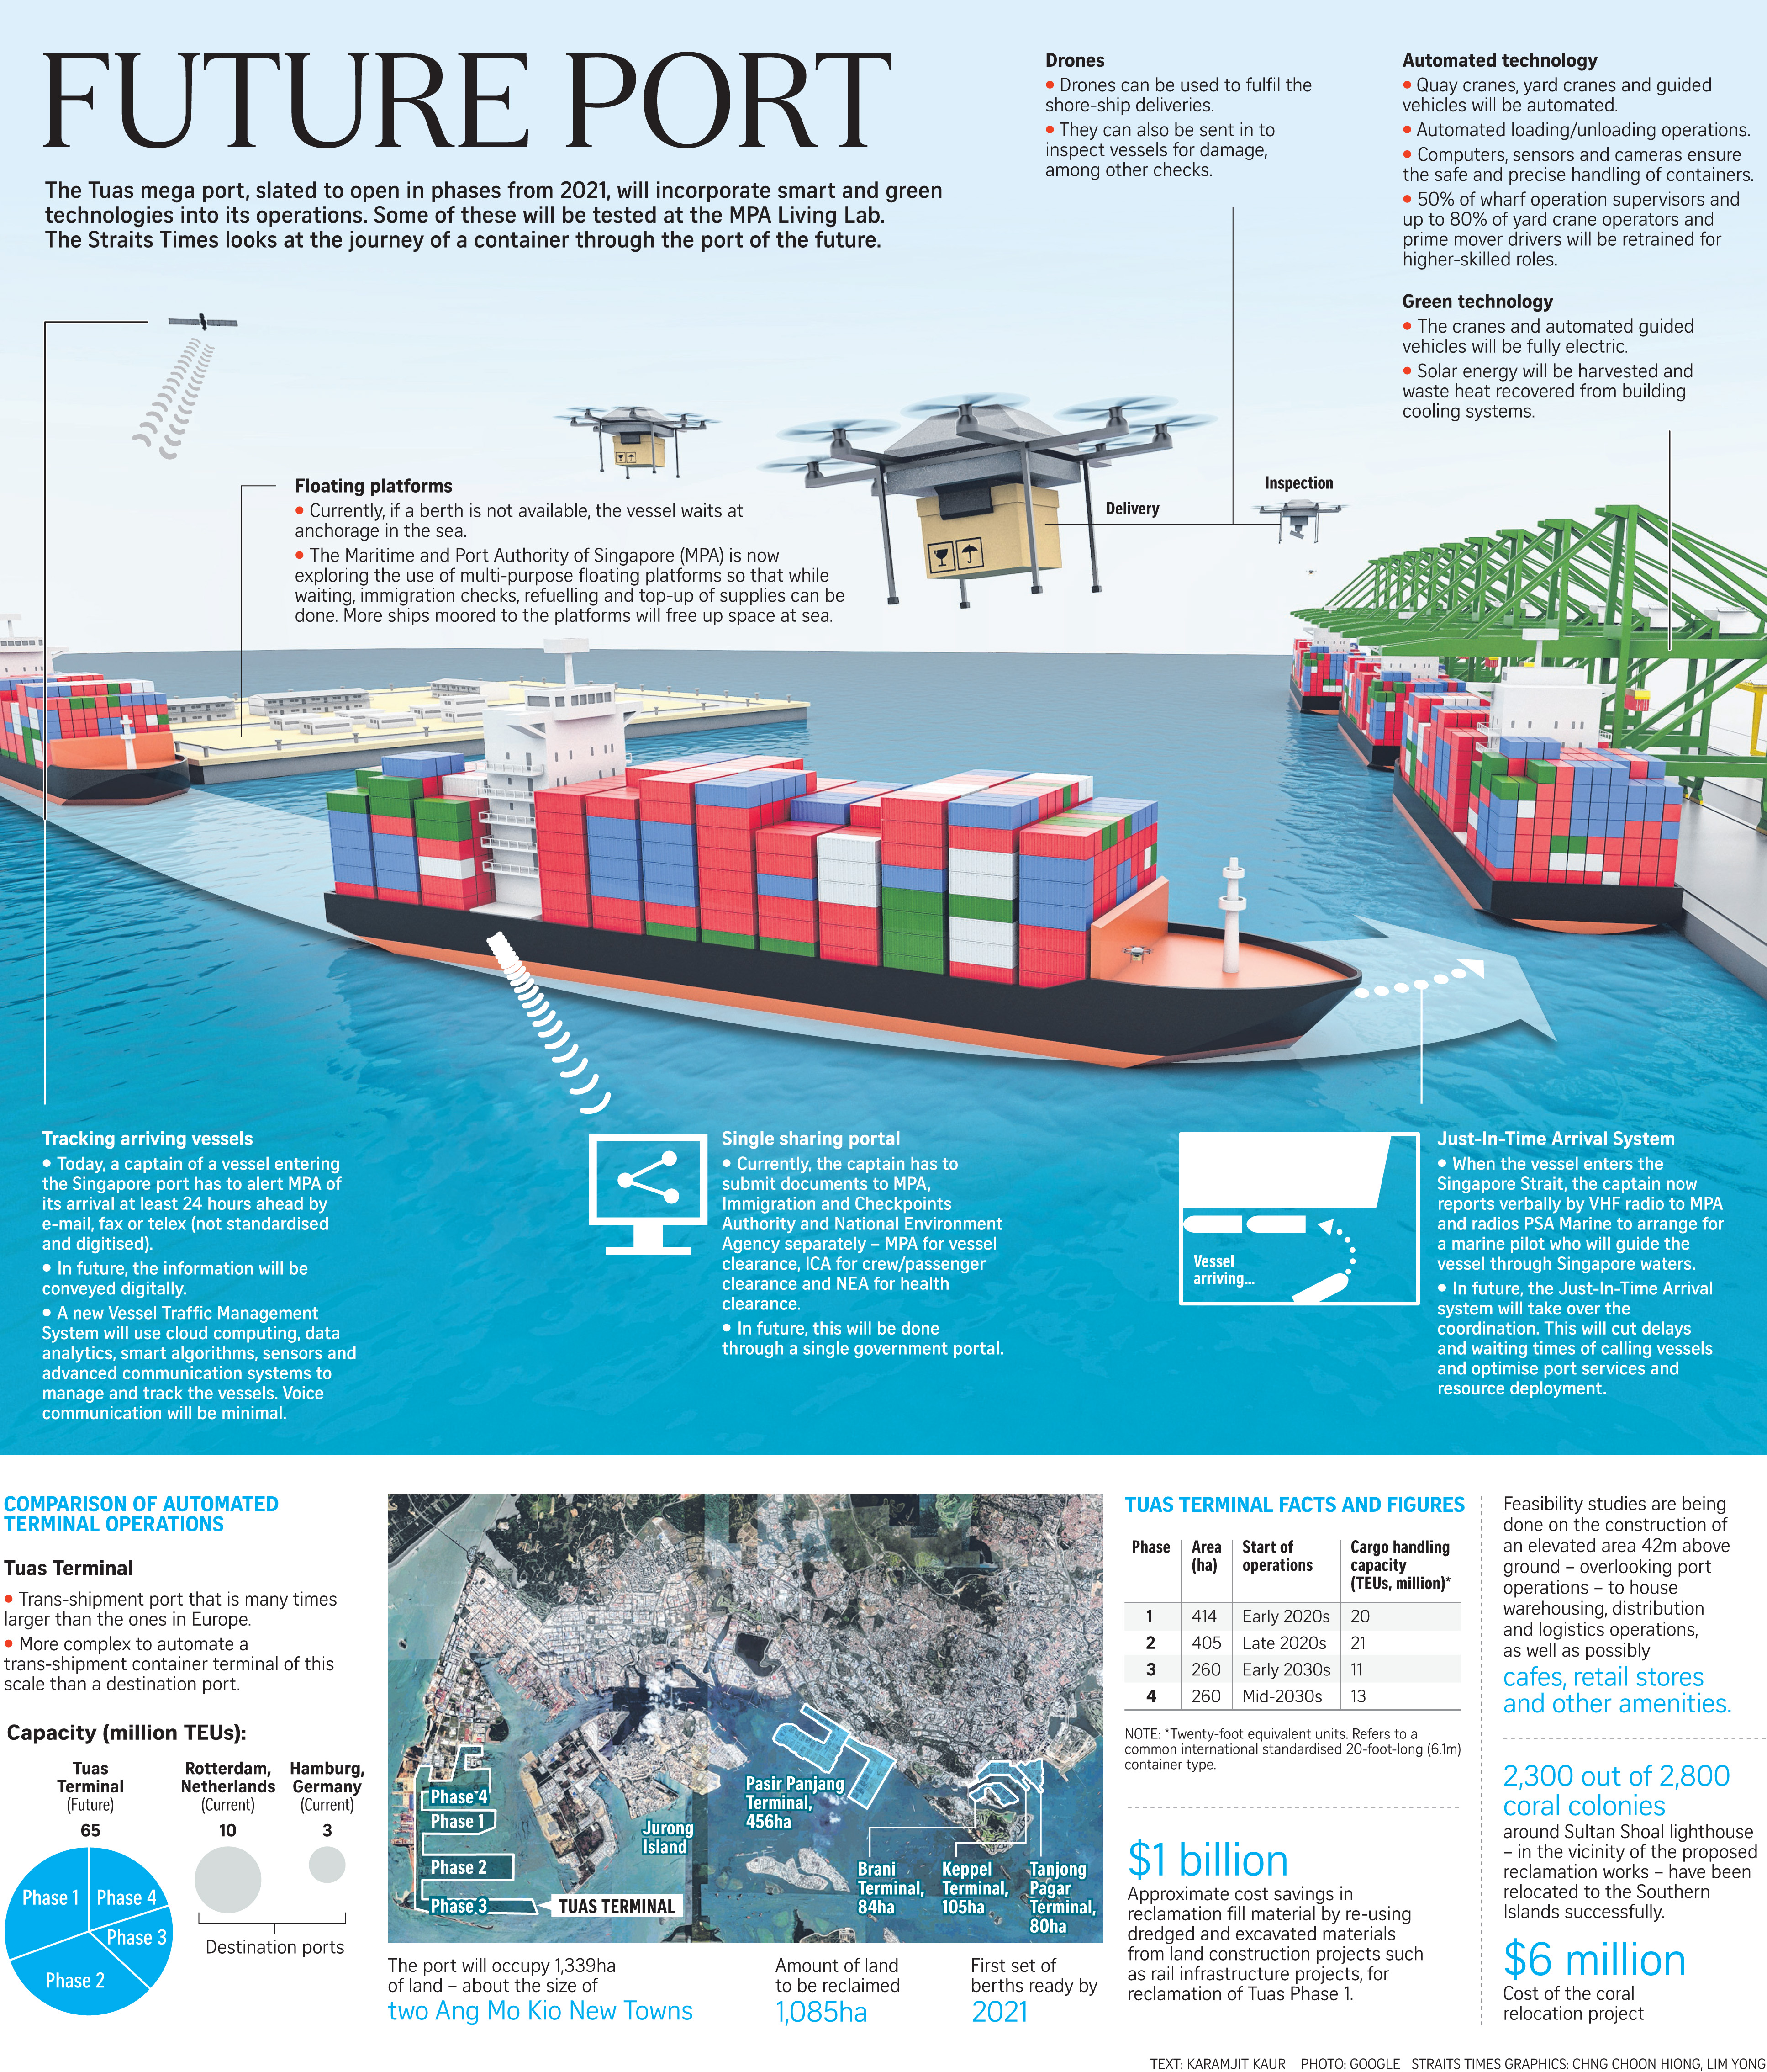
Singapore’s Future Port

Slide 13





SLA’s Strategic Thrusts
To drive awareness and adoption of technology to improve business processes and business models
To connect with overseas TACs and organizations and identify business opportunities
To support logistics companies in their human capital and capability building efforts
To leverage technology and Singapore as testbed to develop new logistics value differentiators
Uplift the image of the Logistics industry
Digitalisation & Innovation Technology
Internationalisation
Enterprise Capability Building
Future of Logistics
Industry Profiling

Slide 14
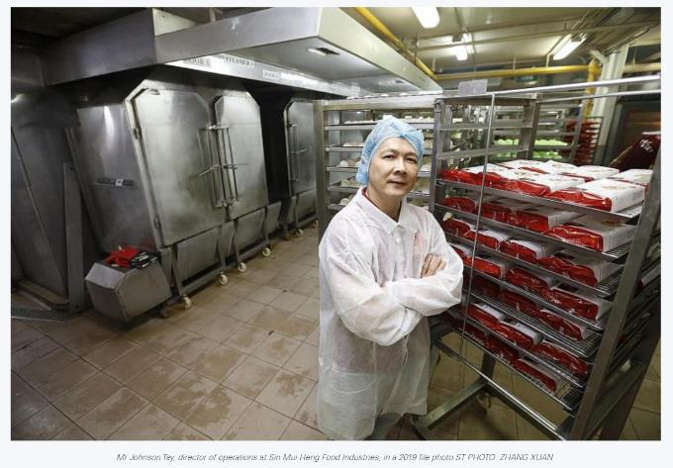
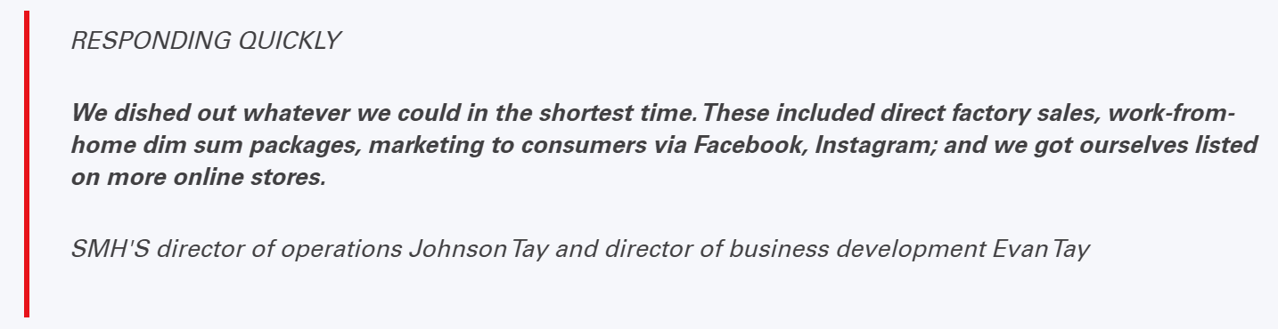
Case Study - Sin Mui Heng (SMH) Food Industries
Sourcing for raw materials from overseas, such as packaging materials and personal protective equipment, was a challenge for the Singapore firm.
Exporting food products, such as dim sum and pau, to the Middle East also met with some issues due to Covid-19 restrictions.
To get around the roadblocks, SMH decided to produce more machine-made products mainly for retail sale instead. This means cutting down on labour-intensive lines which produce handmade items that are for hotels and restaurants.
In order to ship products to the Middle East, the firm carved out alternative shipment channels. SMH also worked with its distributor in the United Arab Emirates, with the support of Enterprise Singapore, to send the food products to Kuwait via trucks instead of the usual approach of using sea freight.

Slide 15
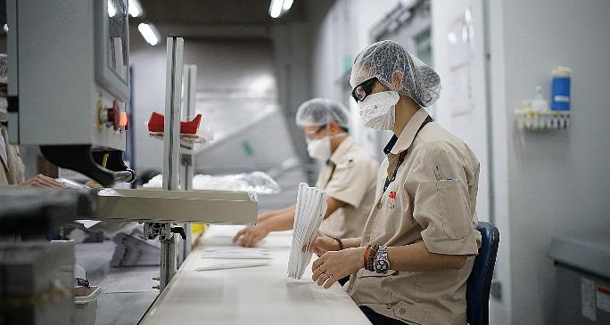
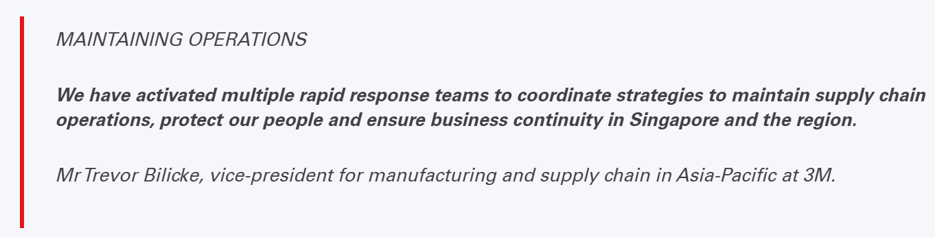
Case Study - 3M Singapore
United States-based industrial giant's products are essential in fighting Covid-19 around the world. 3M’s plants in Woodlands and Tuas manufacture respirators, polymer-processing additives and adhesives among a host of other products.
3M's global network has helped the company to obtain raw materials and packaging materials for its plants when needed.
Since February, the company has managed its supplies in a 30/60/90-day planning cycle.
They have accelerated new internal and external supply qualifications to help alleviate issues where demand far exceeds supply or where there are export restrictions
Despite additional restrictions mandated by different governments in the region, 3M’s manufacturing operations for disposable respirators in Asia have been running 24/7 since late January, says Mr Trevor Bilicke, vice-president for manufacturing and supply chain in Asia-Pacific for the industrial giant.
PHOTO: 3M

Slide 16
In summary: Singapore’s Future for Logistics

Slide 17

Singapore Logistics Association
THANK YOU

Slide 18


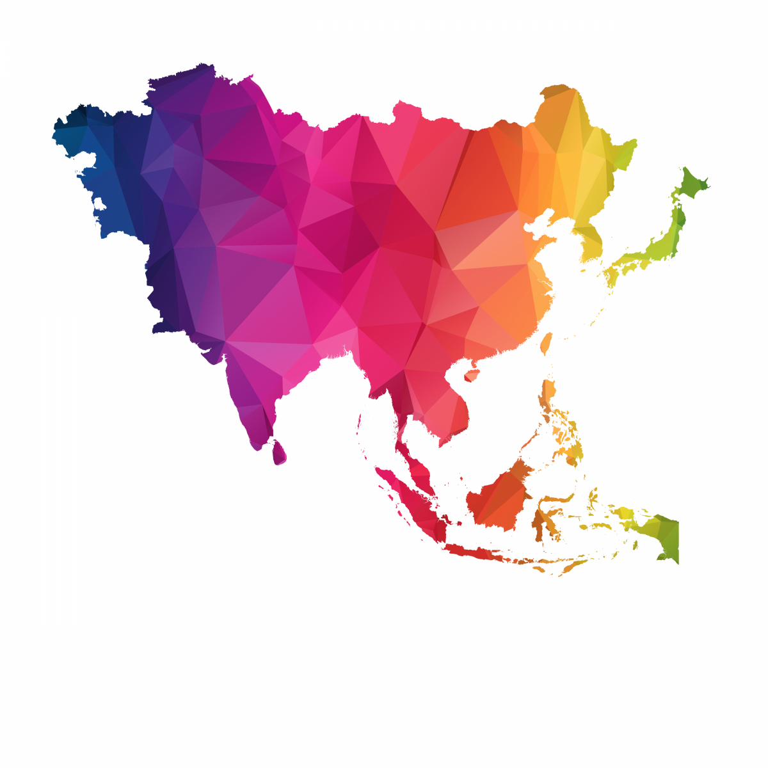

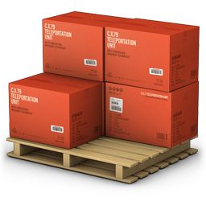
Our Strengths
Regional Hub
for Global Players
Preferred Location
World-Class
Connectivity
7th
LPI Rank
in 2018¹
S$87,108
Per Capita GDP at Current Prices in 2018²
3.1%
Real GDP Growth in 2018²
17.6%
Nominal GDP for the Wholesale & Retail Trade Sector in 2018²
6.7%
Nominal GDP for the Transportation & Storage Sector in 2018²
¹Source: World Bank
²Source: Singstat

Slide 19
Singapore Logistics Industry as an Integral Part of Our Economy
Logistics Spaces
Air Freight
Forwarding
Sea Freight
Forwarding
Multimodal
Transport
Land
Transportation
Partnering Key Industries
Aerospace & Aviation
Agriculture & Aquaculture
Automotive
Biotech & Pharmaceutical
Chemicals / Petrochemicals
Info-Comms Technology
Construction & Engineering
Electronics & Semiconductor
Entertainment & Media
Fashion & Apparel
Food, Beverages & Hospitality
Furniture & Furnishings
Healthcare & Medical
Marine & Offshore
Meetings, Incentives, Conventions & Exhibitions
Fast Moving Consumer Goods

